Slide 1
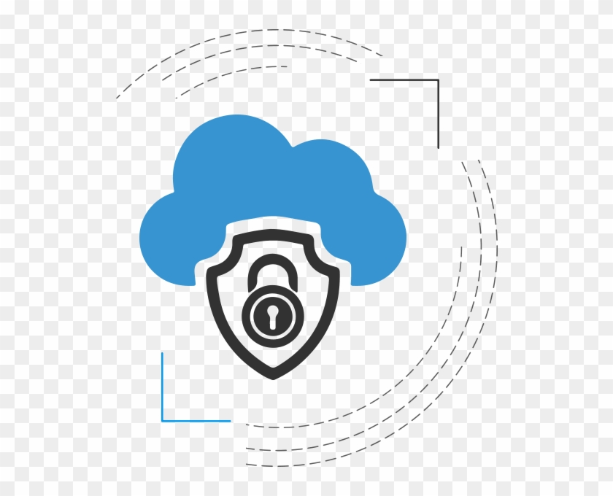
Weeks 15 Fundamental Cloud Security
Cloud Computing
Dr. Rafiullah Khan
ICS/IT
https://rafiyz.github.io/courses/CloudComp/cloud.htm

Slide 2
Outline
Basic terms and concepts
Threat Agents
Cloud Security Threats

Slide 3
Basic Terms and Concepts

Slide 4
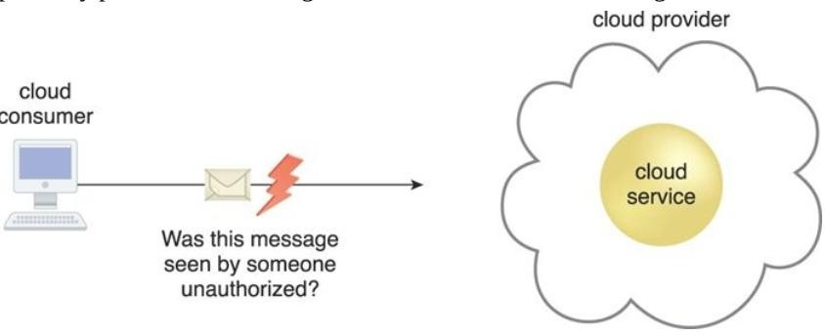
Confidentiality
The characteristic of something being made accessible only to authorized parties.
Within cloud environments, confidentiality primarily pertains to restricting access to data in transit and storage.
The message issued by the cloud consumer to the cloud service is considered confidential only if it is not accessed or read by an unauthorized party.

Slide 5
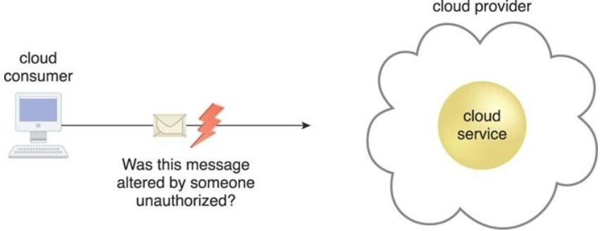
Integrity
The characteristic of not having been altered by an unauthorized party.
An important issue that concerns data integrity in the cloud is whether a cloud consumer can be guaranteed that the data it transmits to a cloud service matches the data received by that cloud service.
The message issued by the cloud consumer to the cloud service is considered to have integrity if it has not been altered.

Slide 6
Authenticity & Availability
Authenticity
The characteristic of something having been provided by an authorized source.
Availability
The characteristic of being accessible and usable during a specified time period

Slide 7
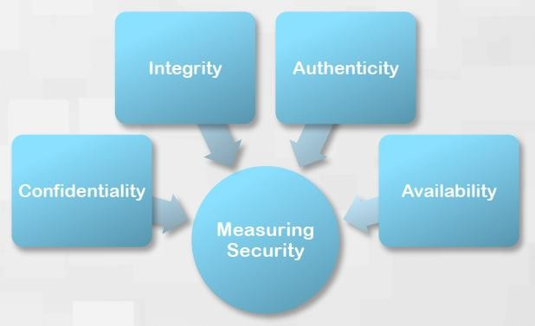
Measuring Security

Slide 8
Threat, Vulnerability and Risk
Threat: a potential security violation that can challenge defenses in an attempt to breach privacy and/or cause harm.
Vulnerability: a weakness that can be exploited either because it is protected by insufficient security controls, or because existing security controls are overcome by an attack.
Risk: the possibility of loss or harm arising from performing an activity.
Two metrics that can be used to determine risk for an IT resource are:
the probability of a threat occurring to exploit vulnerabilities in the IT resource
the expectation of loss upon the IT resource being compromised

Slide 9
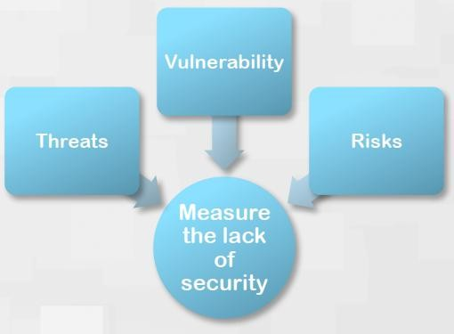
Measuring the lack of Security

Slide 10
Security
Security Controls: are countermeasures used to prevent or respond to security threats and to reduce or avoid risk.
Security Mechanisms: Countermeasures are typically described in terms of security mechanisms, which are components comprising a defensive framework that protects IT resources, information, and services.
Security Policies: A security policy establishes a set of security rules and regulations. Often, security policies will further define how these rules and regulations are implemented and enforced.

Slide 11
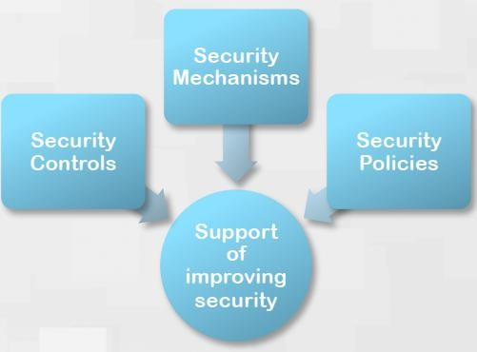
Support of Improving Security

Slide 12
Threat Agent

Slide 13
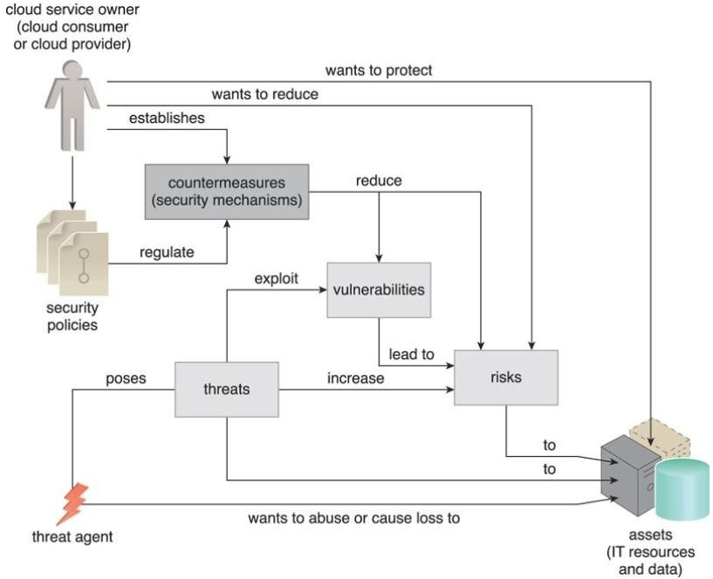
Threat Agent
A threat agent is an entity that poses a threat because it is capable of carrying out an attack.
Cloud security threats can originate either internally or externally, from humans or software programs.
How security policies and security mechanisms are used to counter threats, vulnerabilities, and risks caused by threat agents.

Slide 14
Anonymous Attacker
A non-trusted cloud service consumer without permissions in the cloud.
It typically exists as an external software program that launches network-level attacks through public networks.

Slide 15
Malicious Service Agent
A malicious service agent is able to intercept and forward the network traffic that flows within a cloud.
It typically exists as a service agent (or a program pretending to be a service agent) with compromised or malicious logic.
It may also exist as an external program able to remotely intercept and potentially corrupt message contents.

Slide 16
Trusted Attacker
shares IT resources in the same cloud environment as the cloud consumer and attempts to exploit legitimate credentials to target cloud providers and the cloud tenants with whom they share IT resources.
Trusted attackers (also known as malicious tenants) can use cloud- based IT resources for a wide range of exploitations, including
the hacking of weak authentication processes,
the breaking of encryption,
the spamming of e-mail accounts, or
to launch common attacks, such as denial of service campaigns.

Slide 17
Malicious Insider
Malicious insiders are human threat agents acting on behalf of or in relation to the cloud provider

Slide 18
Cloud Security Threats
This section introduces several common threats and vulnerabilities in cloud-based environments and describes the roles of the aforementioned threat agents.

Slide 19
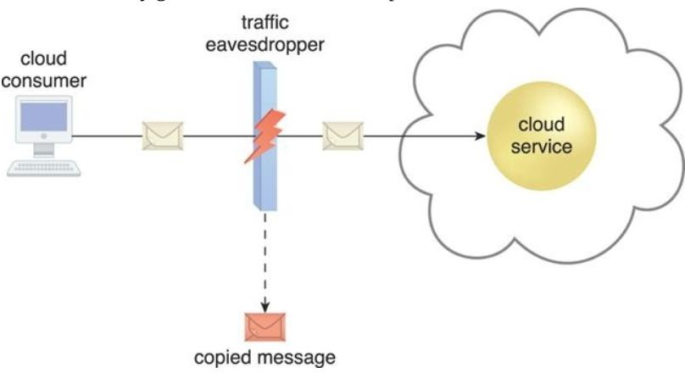
Traffic Eavesdropping
It occurs when data being transferred to or within a cloud (usually from the cloud consumer to the cloud provider) is passively intercepted by a malicious service agent for illegitimate information gathering purposes .
The aim of this attack is to directly compromise the confidentiality of the data and, possibly, the confidentiality of the relationship between the cloud consumer and cloud provider.
An externally positioned malicious service agent carries out a traffic eavesdropping attack by intercepting a message sent by the cloud service consumer to the cloud service. The service agent makes an unauthorized copy of the message before it is sent along its original path to the cloud service.

Slide 20
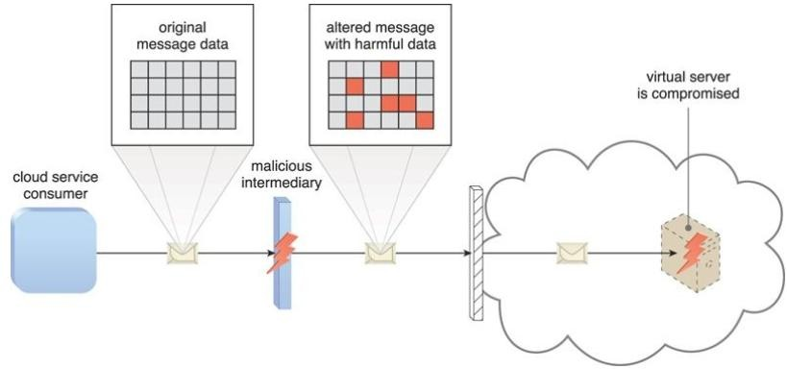
Malicious Intermediary
arises when messages are intercepted and altered by a malicious service agent, thereby potentially compromising the message’s confidentiality and/or integrity.
It may also insert harmful data into the message before forwarding it to its destination.
The malicious service agent intercepts and modifies a message sent by a cloud service consumer to a cloud service (not shown) being hosted on a virtual server. Because harmful data is packaged into the message, the virtual server is compromised.

Slide 21
Denial of Service
The objective of the denial of service (DoS) attack is to overload IT resources to the point where they cannot function properly.
This form of attack is commonly launched in one of the following ways:
The workload on cloud services is artificially increased with imitation messages or repeated communication requests.
The network is overloaded with traffic to reduce its responsiveness and cripple its performance.
Multiple cloud service requests are sent, each of which is designed to consume excessive memory and processing resources.

Slide 22
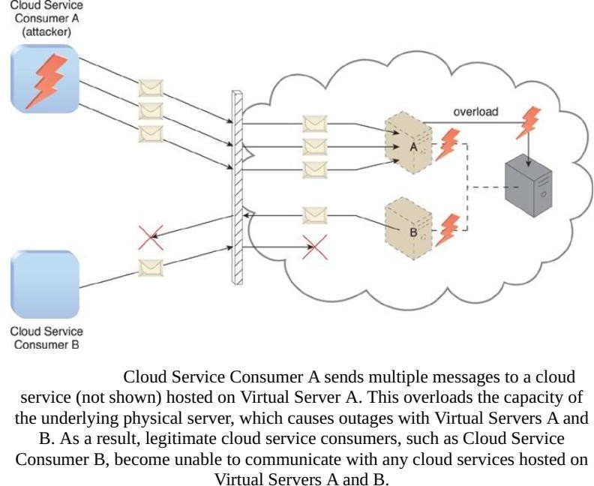

Slide 23
Insufficient Authorization Attack
occurs when access is granted to an attacker erroneously or too broadly, resulting in the attacker getting access to IT resources that are normally protected.
This is often a result of the attacker gaining direct access to IT resources that were implemented under the assumption that they would only be accessed by trusted consumer programs.

Slide 24
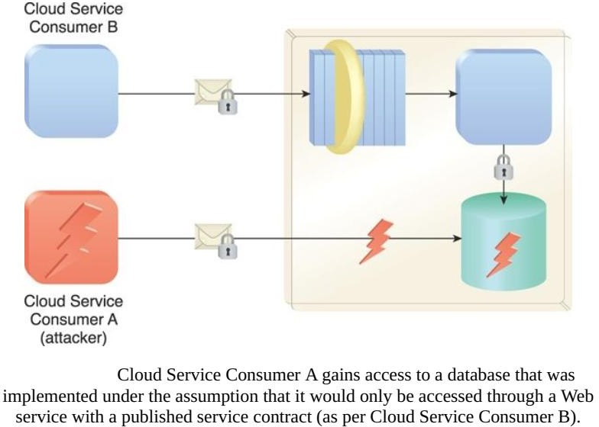

Slide 25
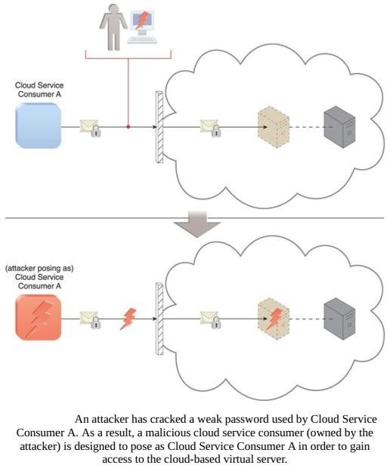
Weak Authentication Attack (Insufficient Authorization)
weak authentication attack can result when weak passwords or shared accounts are used to protect IT resources.
Within cloud environments, these types of attacks can lead to significant impacts depending on the range of IT resources and the range of access to those IT resources the attacker gains .

Slide 26
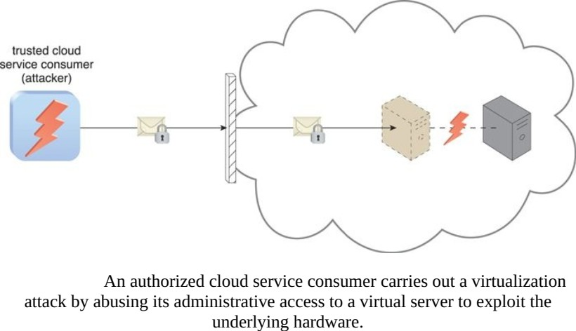
Virtualization Attack
exploits vulnerabilities in the virtualization platform to jeopardize its confidentiality, integrity, and/or availability.
With public clouds, where a single physical IT resource may be providing
virtualized IT resources to multiple cloud consumers, such an attack can have significant repercussions.

Slide 27
Overlapping Trust Boundaries
If physical IT resources within a cloud are shared by different cloud service consumers, these cloud service consumers have overlapping trust boundaries.
Malicious cloud service consumers can target shared IT resources with the intention of compromising cloud consumers or other IT resources that share the same trust boundary.

Slide 28
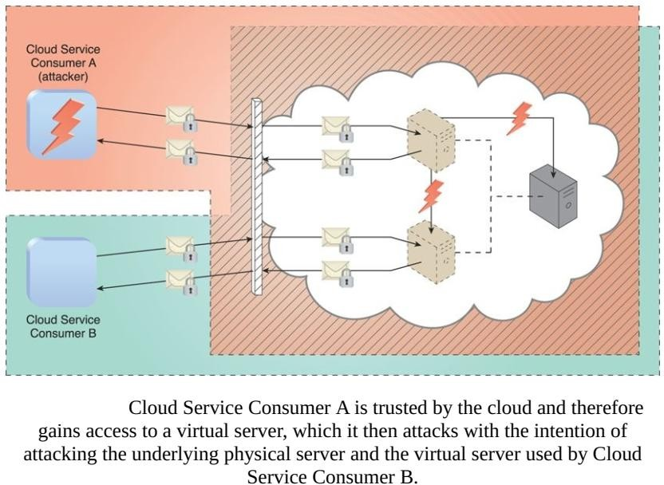

Slide 29
Additional Considerations
Cloud consumers need to be aware that they may be introducing security risks by deploying flawed cloud-based solutions.
An understanding of how a cloud provider defines and imposes proprietary, and possibly incompatible, cloud security policies is a critical part of forming assessment criteria when choosing a cloud provider vendor.
Liability, indemnity, and blame for potential security breaches need to be clearly defined and mutually understood in the legal agreements signed by cloud consumers and cloud providers.
It is important for cloud consumers, subsequent to gaining an understanding of the potential security-related issues specific to a given cloud environment, to perform a corresponding assessment of the identified risks.

Slide 30
Cloud Security Mechanisms

Slide 31
Content
Encryption
Hashing
Digital Signature
Identity and Access Management (IAM)
Single Sign-On (SSO)
Cloud-Based Security Groups
Hardened Virtual Server Images
“This section establishes a set of fundamental cloud security mechanisms, several of which can be used to counter the security threats described
previously”

Slide 32
Encryption
Data, by default, is coded in a readable format known as plaintext.
Plaintext is vulnerable to unauthorized and potentially malicious access when transmitted over a network, .
The encryption mechanism is a digital coding system dedicated to preserving the confidentiality and integrity of data. It is used for encoding plaintext data into a protected and unreadable format.
Encryption technology commonly relies on a standardized algorithm called a cipher to transform original plaintext data into encrypted data, referred to as ciphertext.

Slide 33
When encryption is applied to plaintext data, the data is paired with a string of characters called an encryption key, a secret message that is established by and shared among authorized parties.
The encryption key is used to decrypt the ciphertext back into its
original plaintext format.
The encryption mechanism can help counter the traffic eavesdropping, malicious intermediary, insufficient authorization, and overlapping trust boundaries security threats.

Slide 34
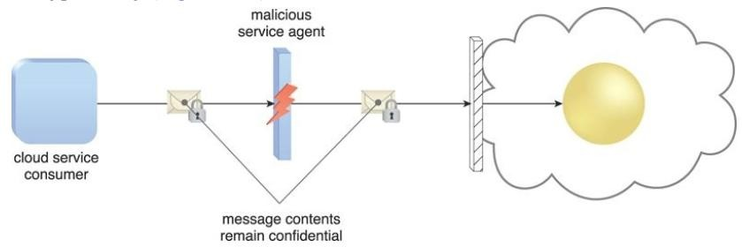
Example
A malicious service agents that attempt traffic eavesdropping are unable to decrypt messages in transit if they do not have the encryption key
A malicious service agent is unable to retrieve data from an encrypted message

Slide 35
Encryption Types
Symmetric Encryption
Symmetric encryption uses the same key for both encryption and decryption, both of which are performed by authorized parties that use the one shared key.
Also known as secret key cryptography, messages that are encrypted with a specific key can be decrypted by only that same key
Note that symmetrical encryption does not have the characteristic of non- repudiation.

Slide 36
Asymmetric Encryption
Asymmetric encryption relies on the use of two different keys, namely a private key and a public key. With asymmetric encryption, the private key is known only to its owner while the public key is commonly available.
A document that was encrypted with a private key can only be correctly decrypted
with the corresponding public key.
Conversely, a document that was encrypted with a public key can be decrypted only using its private key counterpart.
Asymmetric encryption is almost always computationally slower than symmetric encryption.
Private key encryption therefore offers integrity protection in addition to
authenticity and non-repudiation.

Slide 37
Hashing
The hashing mechanism is used when a one-way, non-reversible form of data protection is required.
Once hashing has been applied to a message, it is locked and no key is provided for the message to be unlocked.
A common application of this mechanism is the storage of passwords.
Hashing technology can be used to derive a hashing code or message digest from a message, which is often of a fixed length and smaller than the original message.
The message sender can then utilize the hashing mechanism to attach the message digest to the message.
The recipient applies the same hash function to the message to verify that the produced message digest is identical to the one that accompanied the message.
Any alteration to the original data results in an entirely different message digest and clearly indicates that tampering has occurred.

Slide 38
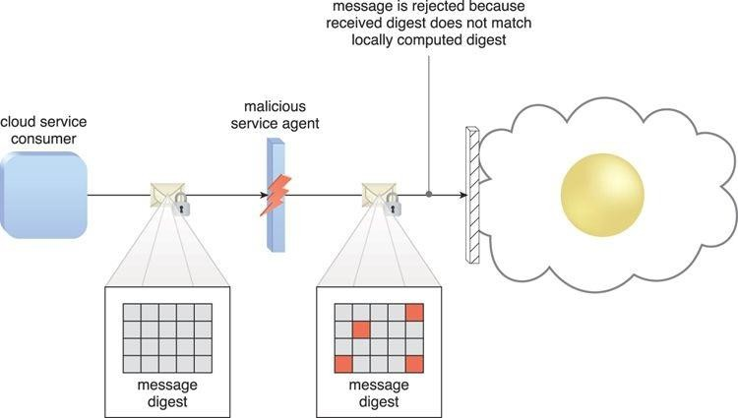
Usage and Example
Usage: protecting stored data, malicious intermediary and insufficient authorization
A hashing function is applied to protect the integrity of a message that is intercepted and altered by a malicious service agent, before it is forwarded.

Slide 39
Digital Signature
The digital signature mechanism is a means of providing data authenticity and integrity through authentication and non- repudiation.
A message is assigned a digital signature prior to transmission, which is then rendered invalid if the message experiences any subsequent, unauthorized modifications.
A digital signature provides evidence that the message received is the same as the one created by its rightful sender.
The digital signature mechanism helps mitigate the malicious intermediary, insufficient authorization, and overlapping trust boundaries security threats

Slide 40
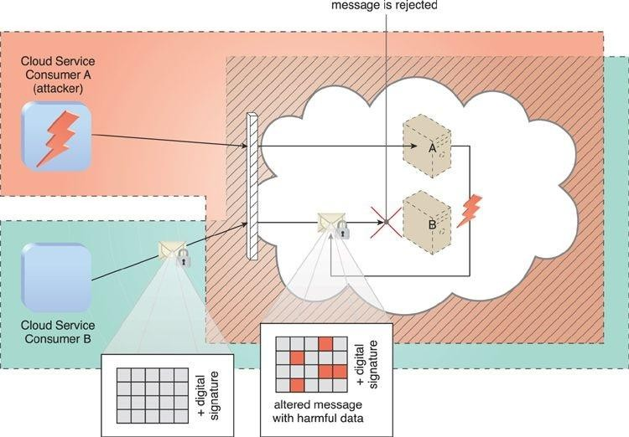
Cloud Service Consumer B sends a message that was digitally signed but was altered by trusted attacker Cloud Service Consumer A. Virtual Server B is configured to verify digital signatures before processing incoming messages even if they are within its trust boundary. The message is revealed as illegitimate due to its invalid digital signature, and is therefore rejected by Virtual Server B.

Slide 41
Identity and Access Management (IAM)
The Identity and access management (IAM) mechanism encompasses the components and policies necessary to control and track user identities and access privileges for IT resources, environments, and systems.
Specifically, IAM mechanisms exist as systems comprised of four main components:
Authentication – Username and password combinations remain the most common forms of user authentication credentials managed by the IAM system.
It also can support digital signatures, digital certificates, biometric hardware (fingerprint readers), specialized software (such as voice analysis programs), and locking user accounts to registered IP or MAC addresses.

Slide 42
Authorization – The authorization component defines the correct granularity for access controls and oversees the relationships between identities, access control rights, and IT resource availability.
User Management – Related to the administrative capabilities of the system, the user management program is responsible for creating new user identities and access groups, resetting passwords, defining password policies, and managing privileges.
Credential Management – The credential management system establishes identities and access control rules for defined user accounts, which mitigates the threat of insufficient authorization.
The IAM mechanism is primarily used to counter the insufficient authorization, denial of service, and overlapping trust boundaries threats.

Slide 43
Single Sign-On (SSO)
The single sign-on (SSO) mechanism enables one cloud service consumer to be authenticated by a security broker, which establishes a security context that is persisted while the cloud service consumer accesses other cloud services or cloud-based IT resources.
The SSO mechanism essentially enables mutually independent cloud services and IT resources to generate and circulate runtime authentication and authorization credentials.

Slide 44
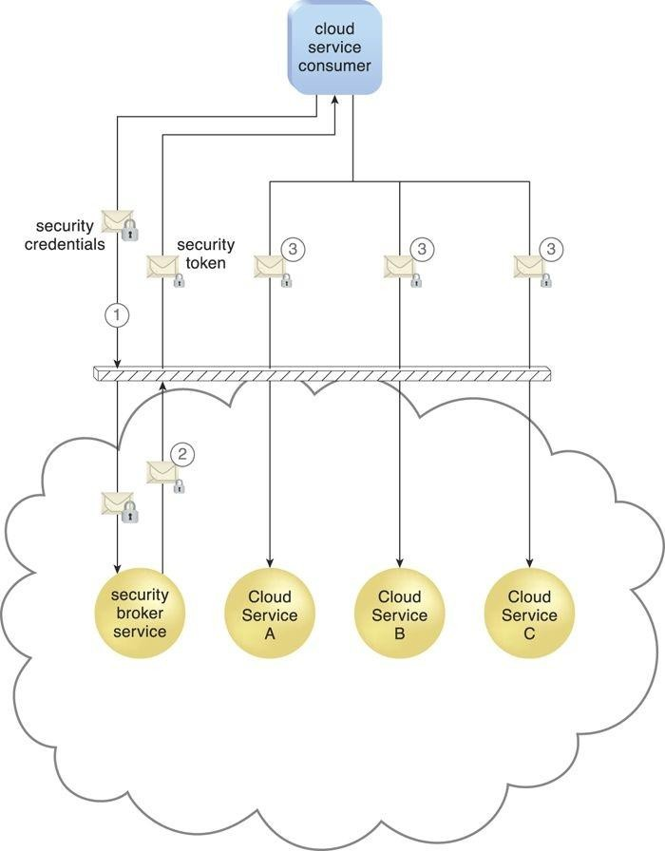
A cloud service consumer provides the security broker with login credentials (1). The security broker responds with an authentication token (message with small lock symbol) upon successful authentication, which contains cloud service consumer identity information (2) that is used to automatically authenticate the cloud service consumer across Cloud Services A, B, and C

Slide 45
Hardened Virtual Server Images
Hardening is the process of stripping unnecessary software from a system to limit potential vulnerabilities that can be exploited by attackers.
Removing redundant programs, closing unnecessary server ports, and disabling unused services, internal root accounts, and guest access are all examples of hardening.
A hardened virtual server image is a template for virtual service instance creation that has been subjected to a hardening process. This generally results in a virtual server template that is significantly more secure than the original standard image.

Slide 46
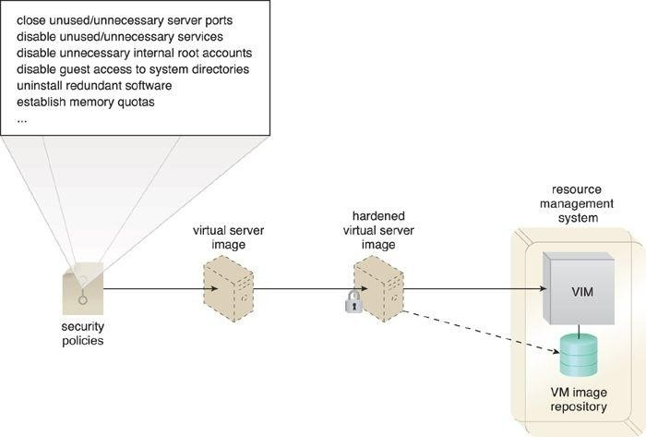
A cloud provider applies its security policies to harden its standard virtual server images. The hardened image template is saved in the VM images repository as part of a resource management system

